Slide 1
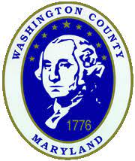
WASHINGTON COUNTY HAZARD MITIGATION PLAN UPDATE
Public Meeting
January 19, 2023 ~ 5:00 p.m.

Slide 2
AGENDA
Welcome & Introductions
What is a hazard mitigation plan?
Hazards/Risks
Project Types
Q&A
Public Survey Link: https://forms.gle/aqEGk2mZpVjZHxJE7

Slide 3
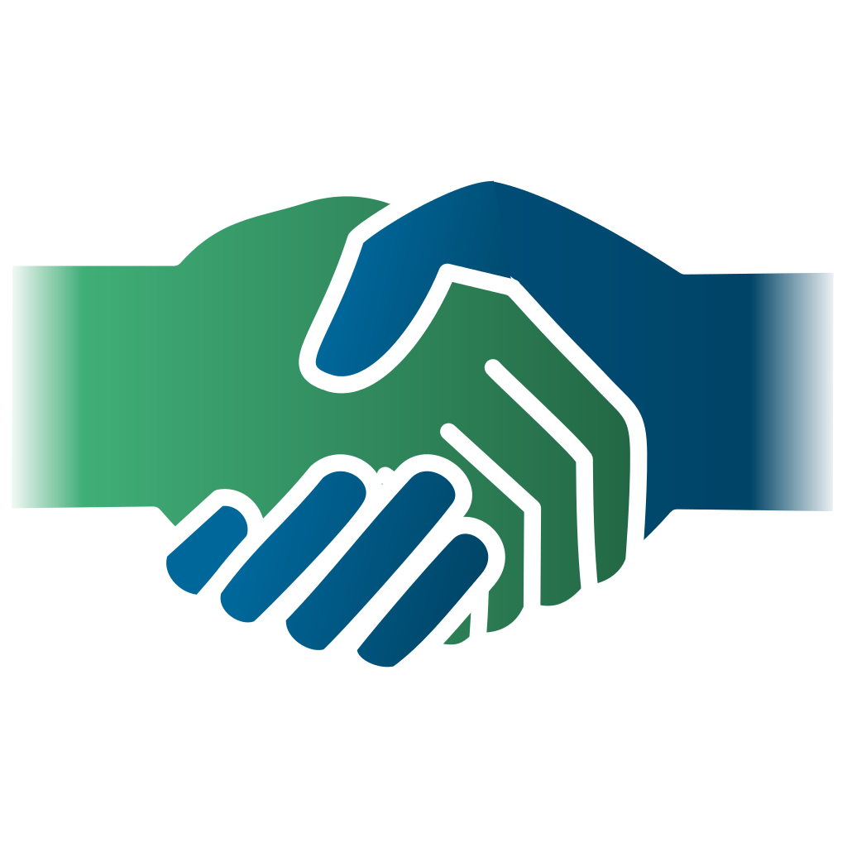
WELCOME AND INTRODUCTIONS
Public Survey Link: https://forms.gle/aqEGk2mZpVjZHxJE7

Slide 4
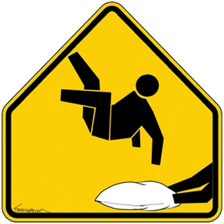
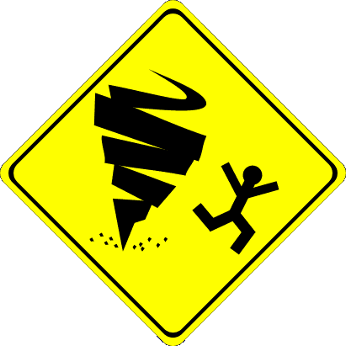
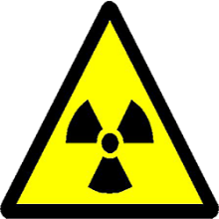
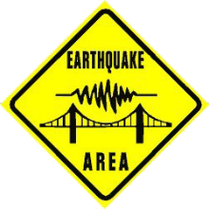
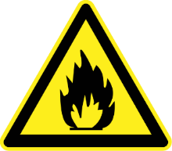
WHAT IS HAZARD MITIGATION?
Federal Emergency Management Agency (FEMA) – Region III
Oversees the hazard mitigation process at the local, regional, state, and national levels
Defines mitigation as, “the effort to reduce loss of life and property by lessening the impact of disasters” (FEMA.gov, 2016)
Public Survey Link: https://forms.gle/aqEGk2mZpVjZHxJE7

Slide 5
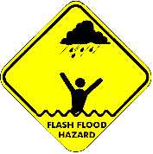
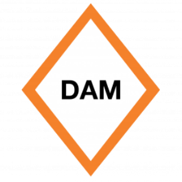
WHAT IS HAZARD MITIGATION?
Maryland Department of Emergency Management
Oversees the hazard mitigation process at the state levels
Ensure jurisdictional participation
Ensure alignment with state project and funding strategies
DEPARTMENT OF
EMERGENCY MANAGEMENT
Public Survey Link: https://forms.gle/aqEGk2mZpVjZHxJE7

Slide 6
HAZARDS / RISKS
Natural Hazards | Technological/Human-Caused Hazards
Drought Extreme Temperatures Fire (Wildland) Flooding (Flash Flood and Riverine) Land Subsidence Reportable Disease Epidemic Severe Summer Weather Severe Winter Weather | Dam Failure Fire (Structure/Industrial) Hazardous Materials Major Transportation Accident Opioid Epidemic
Public Survey Link: https://forms.gle/aqEGk2mZpVjZHxJE7

Slide 7
PROJECT TYPES (1)
Revised Mitigation Goals Maintain and enhance Washington County’s jurisdictions’ capability to make Washington County less vulnerable to hazards. Educate local officials and the public as to the benefits of and opportunities for mitigation, both on community and personal levels. Protect existing and future properties and infrastructure from all hazards that could affect Washington County. Promote sustainable development to improve the quality of life by fostering resilient communities.
Mitigation Type | Description | Examples
Local Plans & Regulations | These actions include government authorities, policies, or codes that influence the way land and buildings are developed and built. | Comprehensive plans Land use ordinances Subdivision regulations Development review Building codes and enforcement Open space preservation
Structure & Infrastructure Projects | These actions involve modifying existing structures and infrastructure to protect them from a hazard or remove them from a hazard area. This could apply to public or private structures as well as critical facilities and infrastructure. This type of action also involves projects to construct structures to reduce the impacts of hazards. | Acquisitions and elevations of structures in flood prone areas Utility undergrounding Structural retrofits Floodwalls and retaining walls Detention and retention structures Culverts Safe rooms
Public Survey Link: https://forms.gle/aqEGk2mZpVjZHxJE7

Slide 8
PROJECT TYPES (2)
Revised Mitigation Goals Maintain and enhance Washington County’s jurisdictions’ capability to make Washington County less vulnerable to hazards. Educate local officials and the public as to the benefits of and opportunities for mitigation, both on community and personal levels. Protect existing and future properties and infrastructure from all hazards that could affect Washington County. Promote sustainable development to improve the quality of life by fostering resilient communities.
Mitigation Type | Description | Examples
Natural Systems Protection | These are actions that minimize damage and losses and also preserve or restore the functions of natural systems. | Sediment and erosion control Stream corridor restoration Forest management Conservation easements Wetland restoration and preservation
Education and Awareness Programs | These are actions to inform and education citizens, elected officials, and property owners about hazards and potential ways to mitigate them. These actions may also include participation in national programs, such as StormReady or Firewise Communities. Although this type of mitigation reduces risk less directly than structural projects or regulation, it is an important foundation. | Radio or television spots Websites with maps and information Real estate disclosure Presentations to school groups or neighborhood organizations Mailings to residents in hazard-prone areas StormReady Firewise Communities
Public Survey Link: https://forms.gle/aqEGk2mZpVjZHxJE7

Slide 9
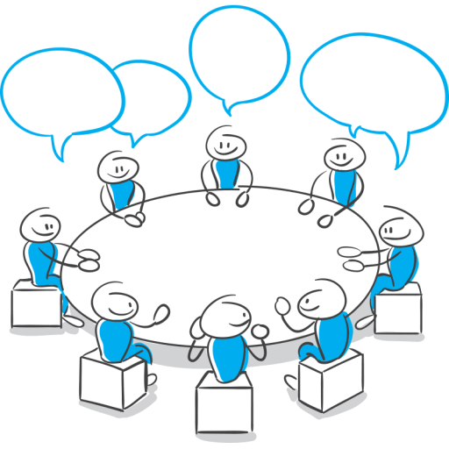
QUESTIONS & ANSWERS (Q&A)
Public Survey Link: https://forms.gle/aqEGk2mZpVjZHxJE7

Slide 10
ADJOURNMENT
Public Survey Link: https://forms.gle/aqEGk2mZpVjZHxJE7

