Slide 1
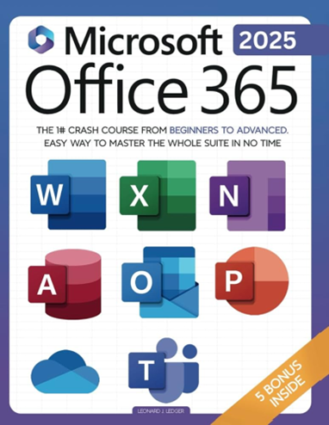
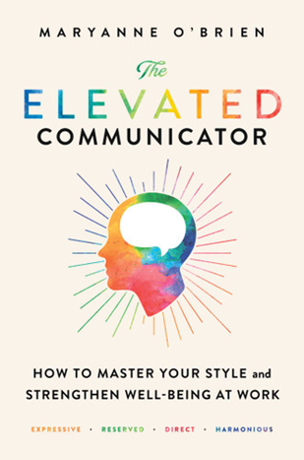
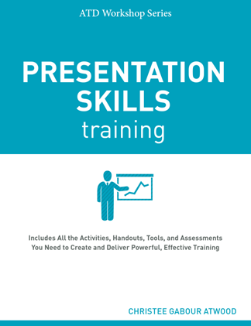

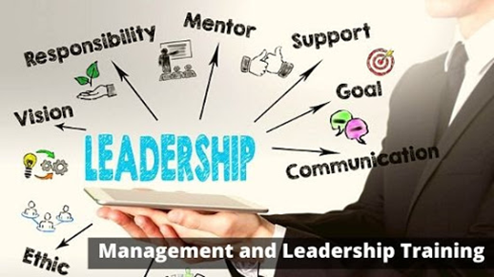


Employee Investment
PERSONAL DEVELOPMENT:
Educational Seminars
Educational Books
Workshops
Certifications

Slide 2




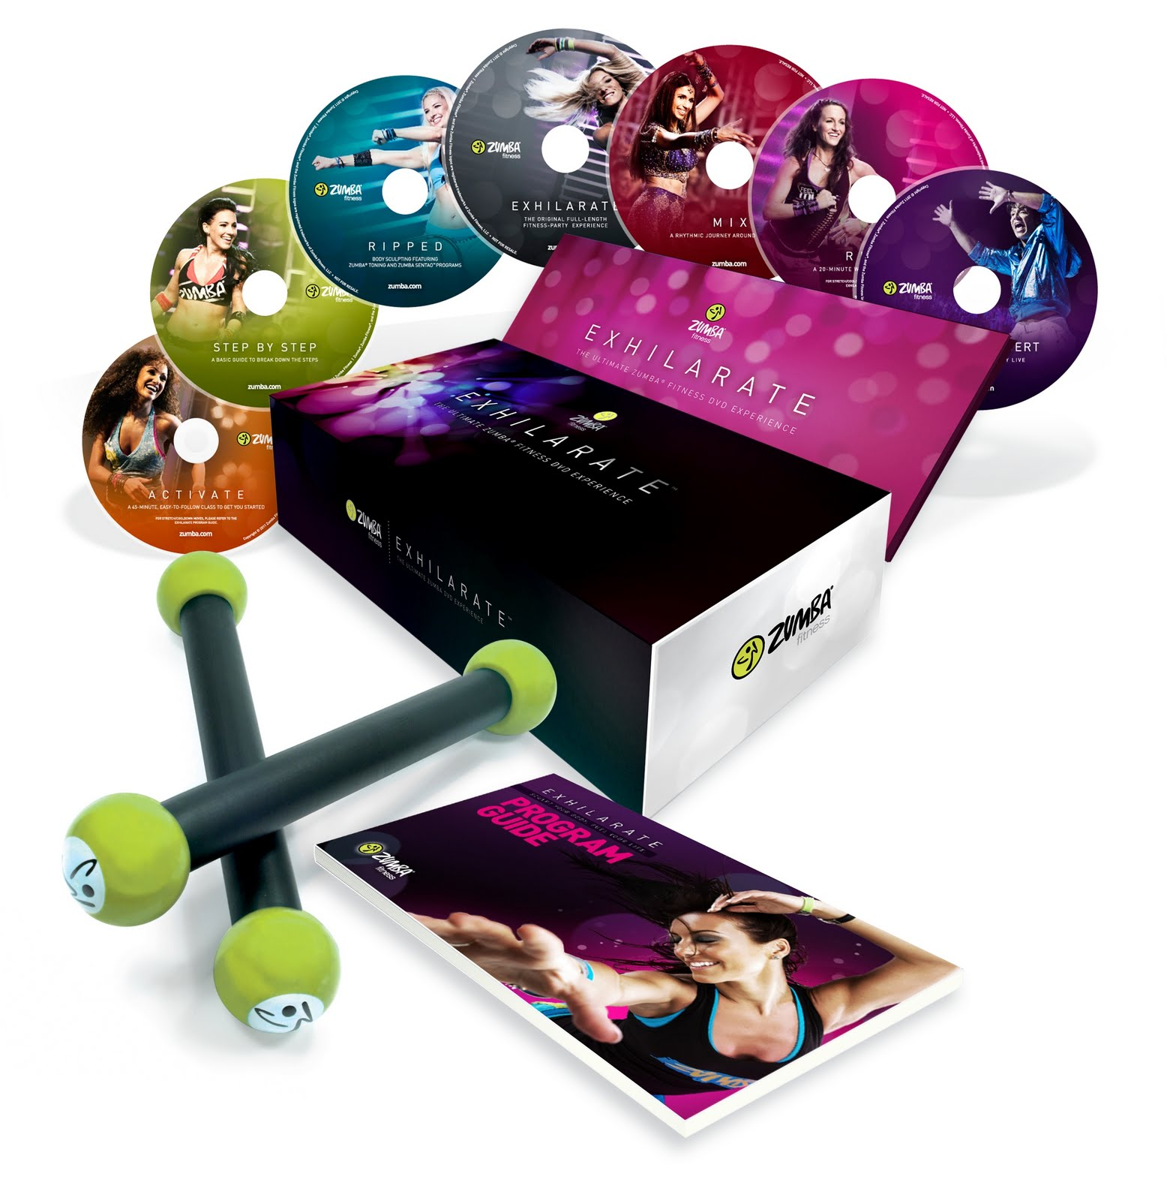



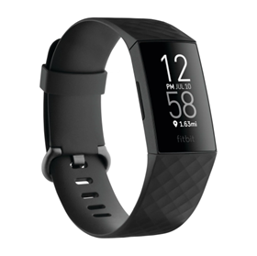
Employee Investment
PERSONAL WELLNESS:
Gym Membership
Yoga/Exercise Classes
Weight Loss Programs/Apps
Fitness Trackers
Fitness DVD’s
Nutrition Classes
Health/Wellness Classes
Smoking Cessation

Slide 3


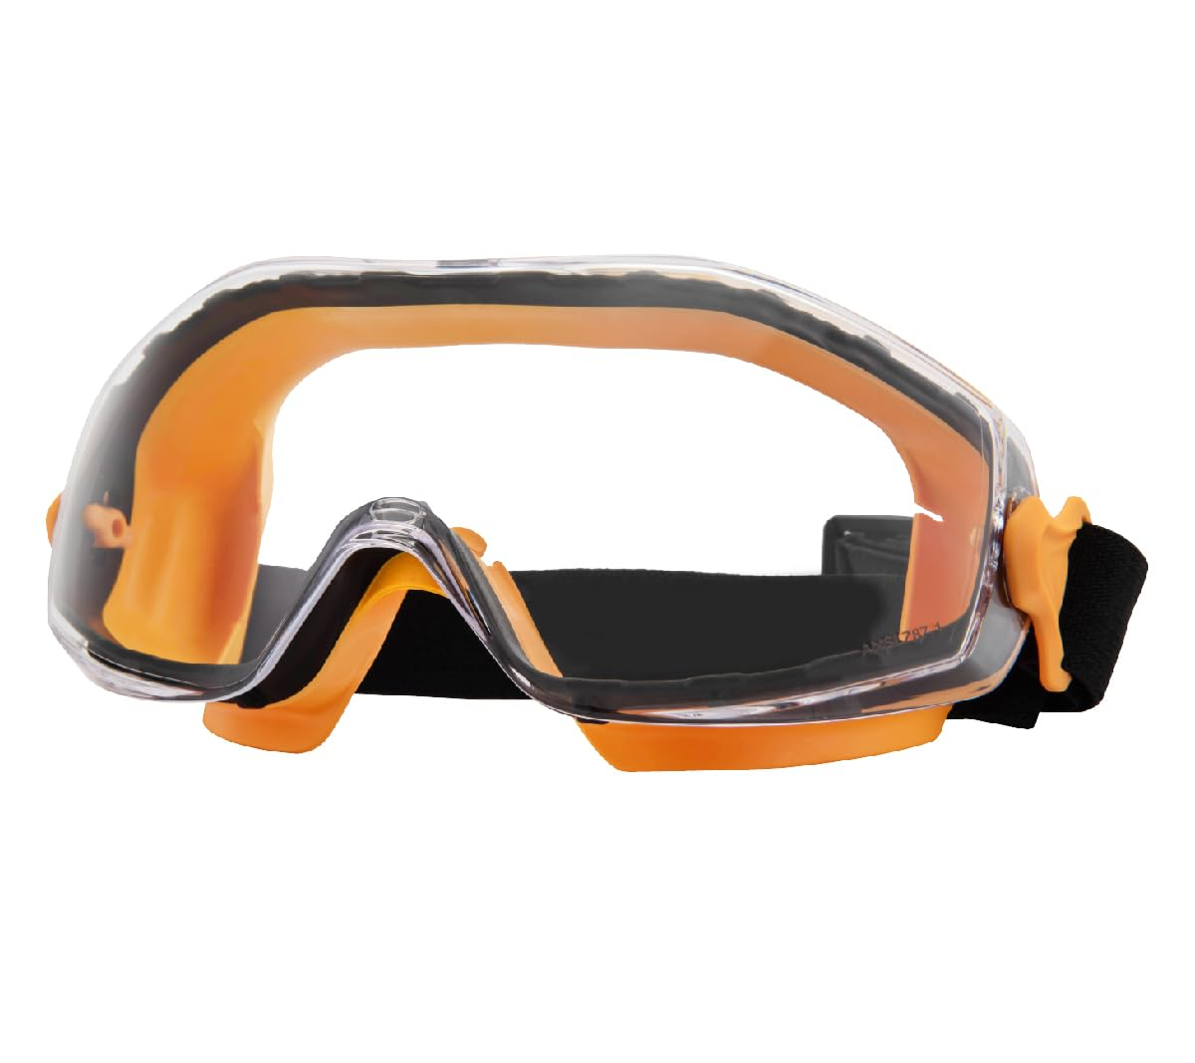
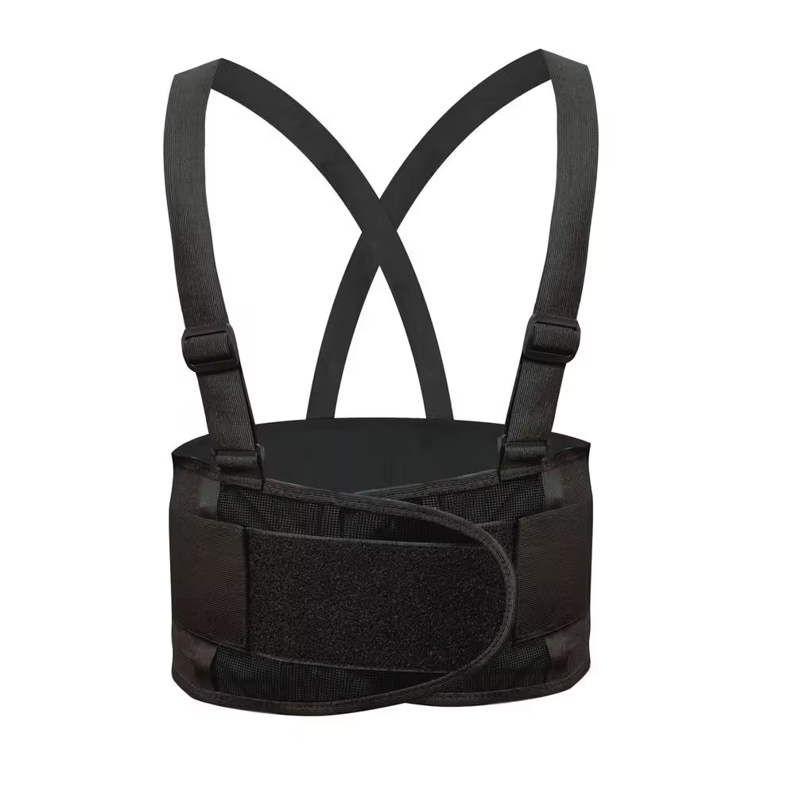
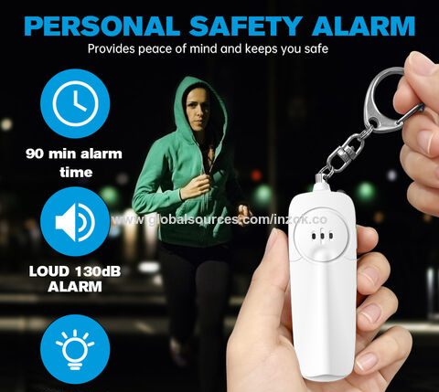
Employee Investment
PERSONAL HEALTH & SAFETY:
Work Boots
Personal Safety Alarms
Lifting/Support Braces

Slide 4
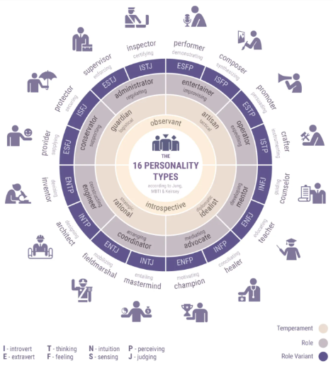



Team Building
Work-Related Workshops/Seminars
Personality Tests
Picnic Lunch
Mini-Golf
Polos/Apparel with County Approved Logo & Branding

